Slide 1

LoRa-Enabled IoT Geo-Fencing using GPS, Arduino & ESP8266
ECA1407 - Embedded Systems
Presented By:
M.Rohith(192311184)
R.Lakshmi Narasimha(192472344)
S.Rajesh Kumar Reddy(192210654)
P. V D Nagendra Reddy(192472399)
K Manoj Kumar(192472395)
Supervisor:
Dr.R.Yuvaraj
Asst. Professor
Saveetha School of Engineering

Slide 2


Abstract
An embedded real-time tracking system is developed using Arduino Nano, NEO-6M GPS and RA-02 LoRa.
GPS coordinates are continuously acquired and processed to determine whether the tracked unit is inside a configurable 20 km geo-fence.
LoRa provides a long-range wireless telemetry link, while ESP8266 provides Wi-Fi/IoT connectivity to the monitoring layer.
A Flask-based dashboard displays live GPS status, latitude, longitude, satellite count, HDOP, serial output and geo-fence status.
The design provides a low-cost modular platform for remote location monitoring and can be extended with maps, alerts and historical logging.

Slide 3
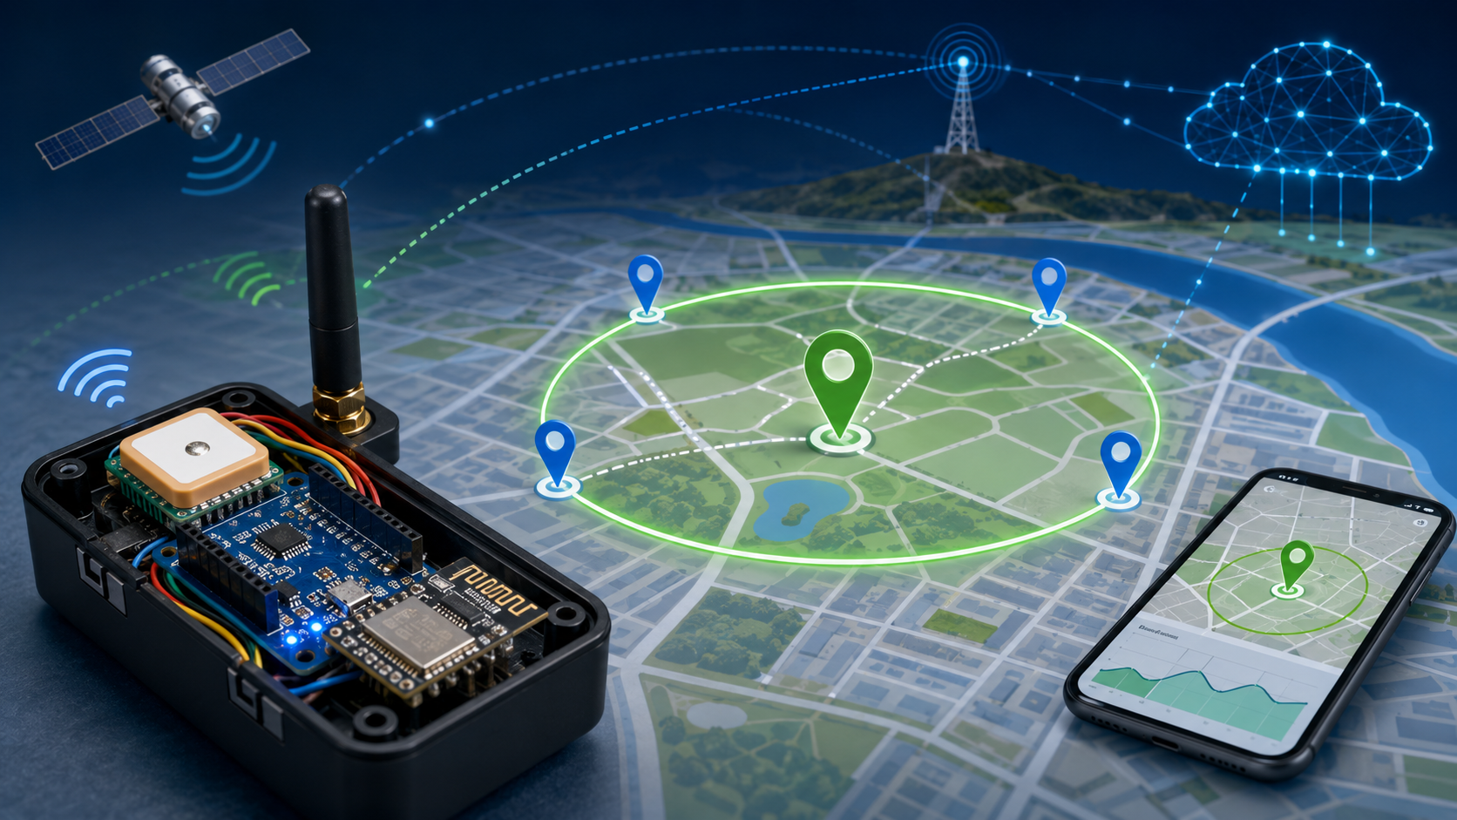
INTRODUCTION
GPS trackers are used in vehicles, bikes, luggage, and even for tracking people or animals.
Normal trackers use SIM cards (GSM) — they need network coverage and cost money every month.
LoRa is a wireless technology that sends small data over long distances (few km) using very little power, and it's completely free to use.
Our system = GPS (finds location) + Arduino (controls everything) + LoRa (sends data far) + ESP8266 (puts data on internet) + Dashboard (shows it live).

Slide 4
Problem Statements
Remote devices may move outside their permitted geographical area without immediate notification.
Manual monitoring of moving devices is difficult and time-consuming.
GPS coordinates alone do not clearly indicate whether a device is inside or outside a permitted region.
Internet connectivity may not always be available at remote locations.
Therefore, a system is required to provide GPS tracking, geo-fence detection, long-range communication and real-time monitoring.

Slide 5
Objectives
To acquire the real-time location of the device using GPS.
To process GPS coordinates using an Arduino Nano.
To implement a 20 km geo-fence around a reference location.
To classify the device location as NORMAL or ALERT.
To transmit location information using LoRa communication.
To connect the system to an IoT dashboard using ESP8266.
To display live GPS and geo-fence information through a web-based dashboard.

Slide 6
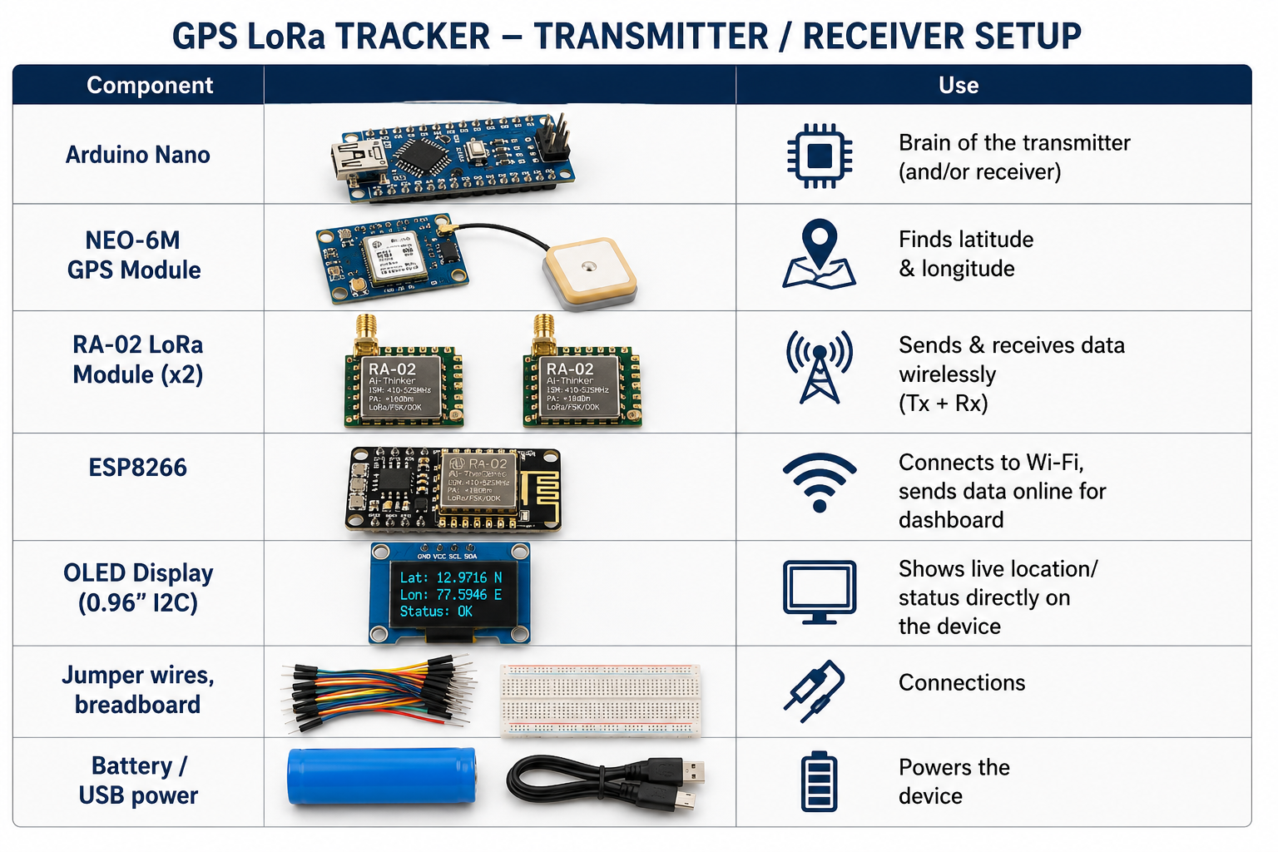
Materials /Components Used
Software
Arduino IDE
Python
Flask
HTML
CSS
JavaScript
TinyGPS++ Library
LoRa Library
Hardware
Arduino Nano
NEO-6M GPS Module
RA-02 LoRa Module
ESP8266 Wi-Fi Module
GPS Antenna
Connecting Wires
USB Cable
Power Supply

Slide 7
LITERATURE REVIEW
S.No | IEEE Paper | Technique | Year | Key Contribution | Limitation
1 | Smart Geo-Fencing System Using LoRaWAN | LoRaWAN + GPS | 2024 | Long-range asset tracking with low power | Limited indoor accuracy
2 | AI-Based Vehicle Geo-Fencing using IoT | GPS + Machine Learning | 2024 | Predicts abnormal vehicle movement | Higher processing requirements
3 | IoT-Based Smart Asset Tracking | ESP8266 + GPS | 2023 | Real-time cloud monitoring | Wi-Fi dependency
4 | LoRa Enabled Intelligent Tracking System | LoRa + Arduino | 2023 | Long-distance communication | Low data transmission speed
5 | Edge AI for Geo-Fencing Applications | TinyML + GPS | 2025 | AI-based anomaly detection on edge devices | Requires optimized AI models

Slide 8
MODULES
Module 1: GPS Location Acquisition Module
Module 2: Arduino Processing and Geo-Fence Logic Module
Module 3: LoRa Wireless Communication Module
Module 4: ESP8266 IoT Connectivity Module
Module 5: Alert and Notification Module
Module 6: Dashboard and Monitoring Module

Slide 9
Module 1: GPS Location Acquisition Module
Methodology :
The NEO-6M GPS module receives signals from available satellites.
GPS generates NMEA data containing location and satellite information.
The Arduino Nano receives GPS data through serial communication.
The TinyGPS++ library processes and extracts useful GPS information.
Latitude, longitude, satellite count and HDOP are obtained.
The system checks whether a valid GPS fix is available before using the location.

Slide 10
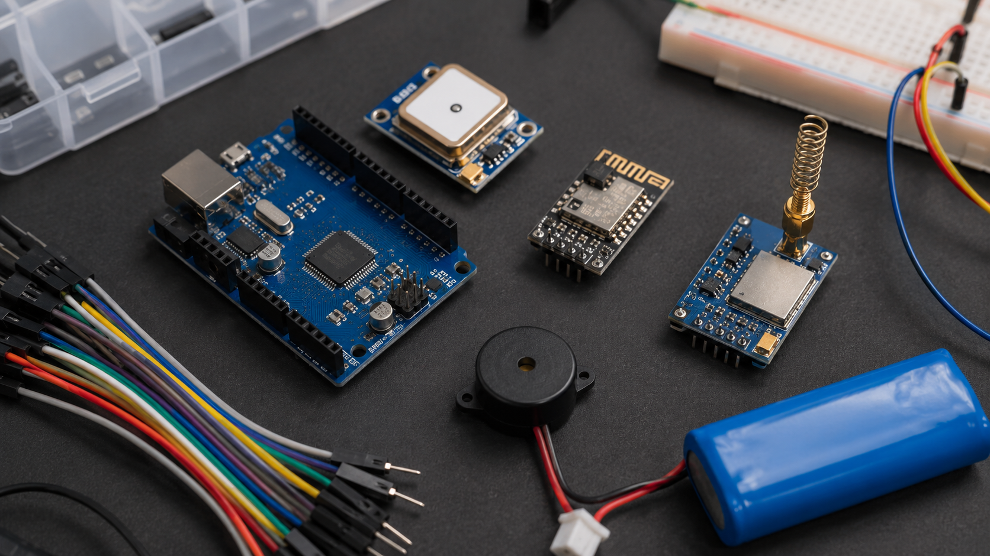
Module 2: Arduino Processing and Geo-Fence Logic Module
Methodology :
Arduino Nano acts as the main processing unit.
The received GPS coordinates are processed continuously.
A fixed reference location is configured as the geo-fence center.
The distance between the current GPS position and the reference point is calculated.
A safe-zone radius of 20 km is applied.
If distance ≤ 20 km → NORMAL
If distance > 20 km → ALERT

Slide 11
Module 3: LoRa Wireless Communication Module
Methodology :
The processed GPS information is prepared as a wireless data packet.
The RA-02 LoRa module transmits the information over a long-range wireless link.
A corresponding LoRa receiver receives the transmitted packet.
Location and geo-fence information can be transferred without depending directly on cellular communication.
LoRa communication provides a suitable wireless link for remote monitoring applications.

Slide 12
Module 4: ESP8266 IoT Connectivity Module
Methodology:
ESP8266 acts as the connectivity layer between the wireless system and the monitoring application.
The received data is processed and prepared for IoT communication.
ESP8266 connects to an available Wi-Fi network.
The processed information is forwarded to the dashboard.
This allows users to monitor the device remotely through a web interface.

Slide 13
Module 5: Dashboard and Monitoring Module
Methodology:
The dashboard receives and displays live GPS information from the system.
It displays latitude, longitude, satellite count and HDOP.
The dashboard shows the current GPS and LoRa communication status.
The distance from the configured reference point is used to display the 20 km geo-fence status.
NORMAL is displayed when the device is within 20 km.
ALERT is displayed when the device moves beyond 20 km.
The dashboard provides a centralized interface for real-time remote monitoring.

Slide 14
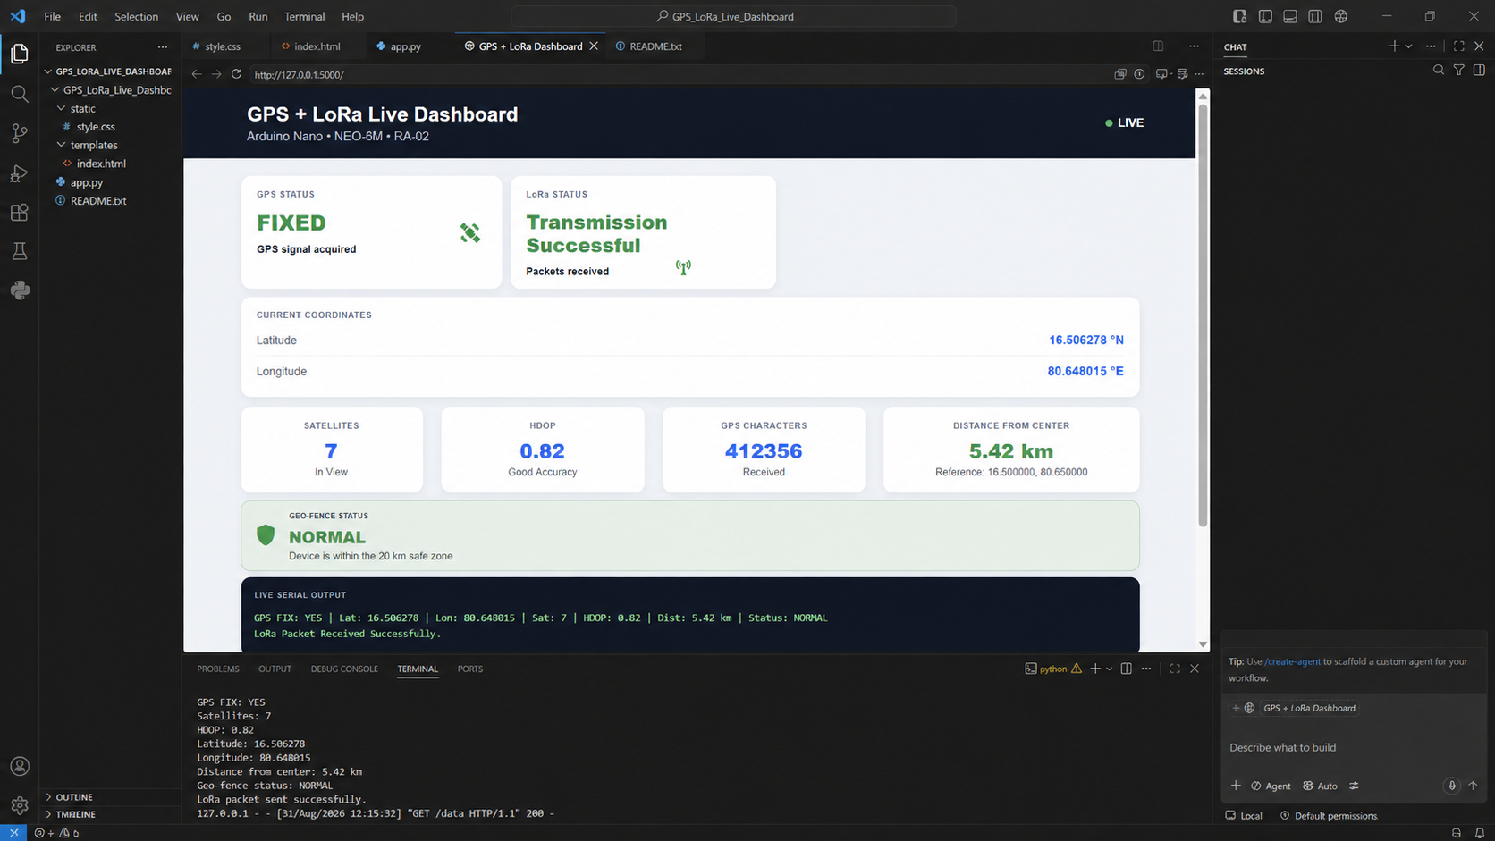
OUTPUT

Slide 15
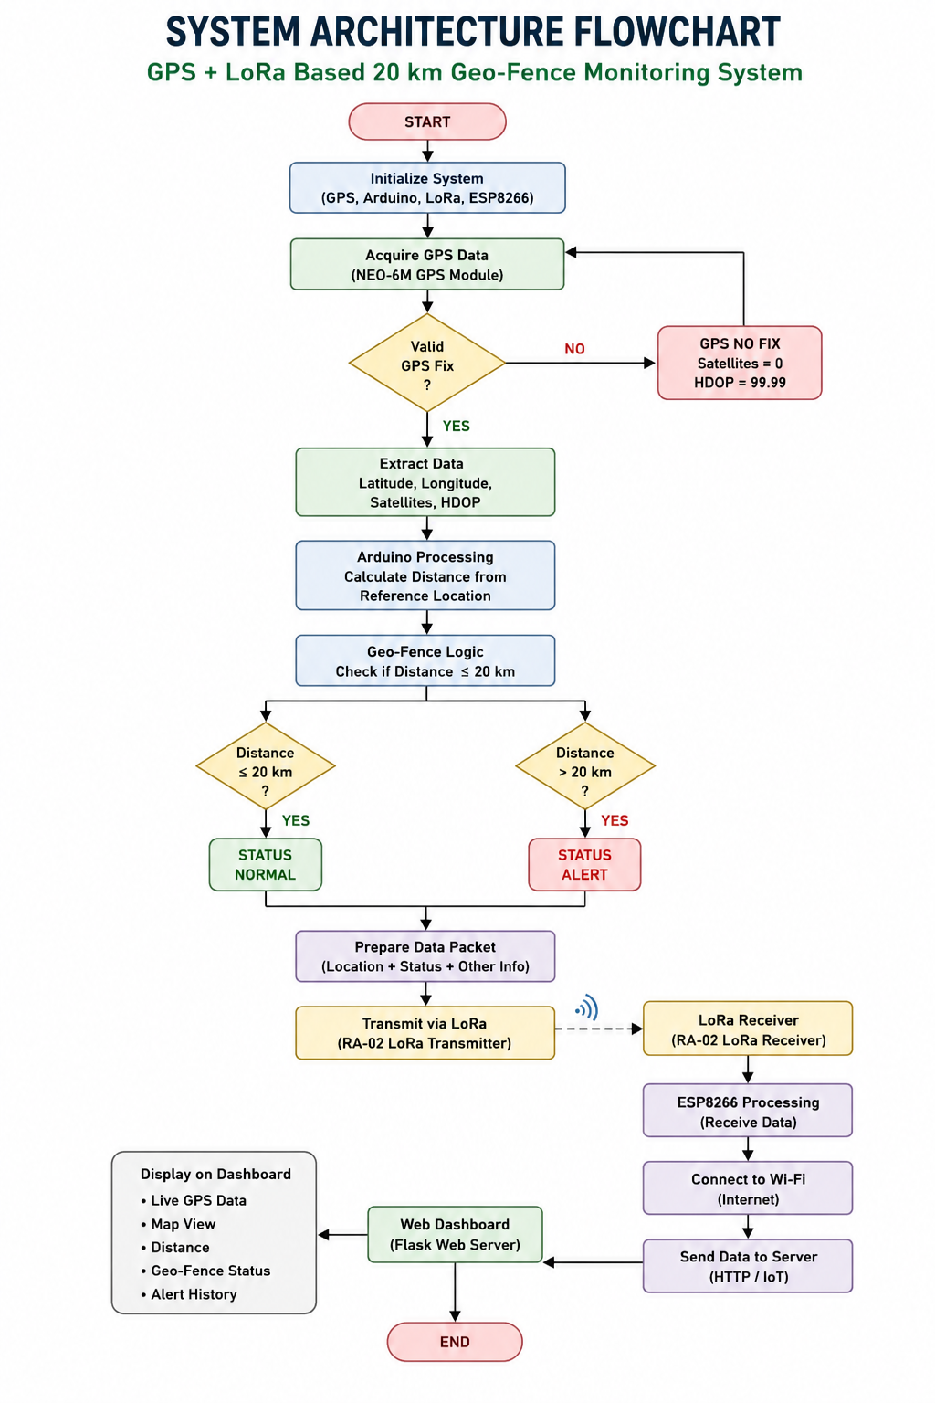
ARCHITECTURE DIAGRAM

Slide 16
Working Methodology / Flowchart
System Operation
Start the system.
Initialize GPS, Arduino and LoRa modules.
Receive GPS data from NEO-6M.
Check for valid GPS fix.
Read latitude and longitude.
Calculate distance from the reference location.
Compare the distance with the 20 km limit.
Generate NORMAL or ALERT status.
Transmit the information through LoRa.
Forward the information through ESP8266.
Display the live information on the dashboard.

Slide 17
Dashboard Result
Prototype Dashboard
The dashboard displays:
GPS Status
Latitude
Longitude
Number of Satellites
HDOP
GPS Character Count
LoRa Transmission Status
Live Serial Output
Geo-Fence Status
Current Testing Observation
GPS FIX: NO Satellites: 0 HDOP: 99.99
The system currently receives GPS communication data, but a valid satellite fix is required before live coordinates can be used for geo-fence classification.

Slide 18
Result Analysis
Expected System Behavior
Condition | Dashboard Status
GPS has valid fix | GPS ACTIVE
Distance ≤ 20 km | NORMAL
Distance > 20 km | ALERT
GPS has no satellite fix | GPS NO FIX
No valid GPS coordinates | Geo-fence decision unavailable
LoRa data received | LoRa CONNECTED/RECEIVING

Slide 19
CONCLUSION
The proposed system integrates GPS, Arduino, LoRa, ESP8266 and a web dashboard.
GPS provides the real-time location of the tracked device.
Arduino processes the coordinates and implements the 20 km geo-fence logic.
LoRa provides a long-range communication mechanism for transferring location information.
ESP8266 provides IoT connectivity for remote monitoring.
The dashboard provides a simple interface for viewing location and NORMAL/ALERT status.
The system can be further developed into a complete real-time tracking and alert platform.

Slide 20
FUTURE ENHANCEMENT
Integration of an interactive live map.
SMS and email alerts when the device crosses the geo-fence.
Storage of location history and alert events.
Cloud-based data storage and analytics.
Monitoring of multiple GPS devices simultaneously.
Mobile-friendly dashboard/application.
Battery and solar-powered field deployment.
Addition of advanced location tracking and route-history features.

Slide 21
REFERENCES
Semtech Corporation, “LoRa and LoRaWAN Technical Overview,” 2026.
Espressif Systems, “ESP8266EX Datasheet,” 2026.
Arduino, “Arduino Documentation and Hardware Reference,” 2026.
u-blox, “NEO-6 GPS Modules Data Sheet,” 2011.
S. Sinha and R. K. Singh, “IoT-Based Geo-Fencing and Tracking System,” International Journal of Embedded Systems, 2023.
A. Kumar and P. Sharma, “Low Power Wide Area Network for IoT Applications,” IEEE IoT Journal, 2022.

Slide 22



